Slide 1
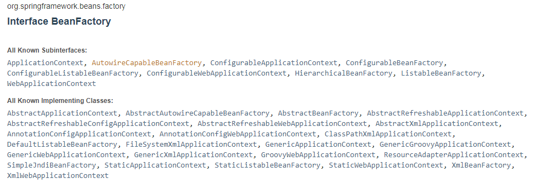
BeanFactory Interface methods

Slide 2
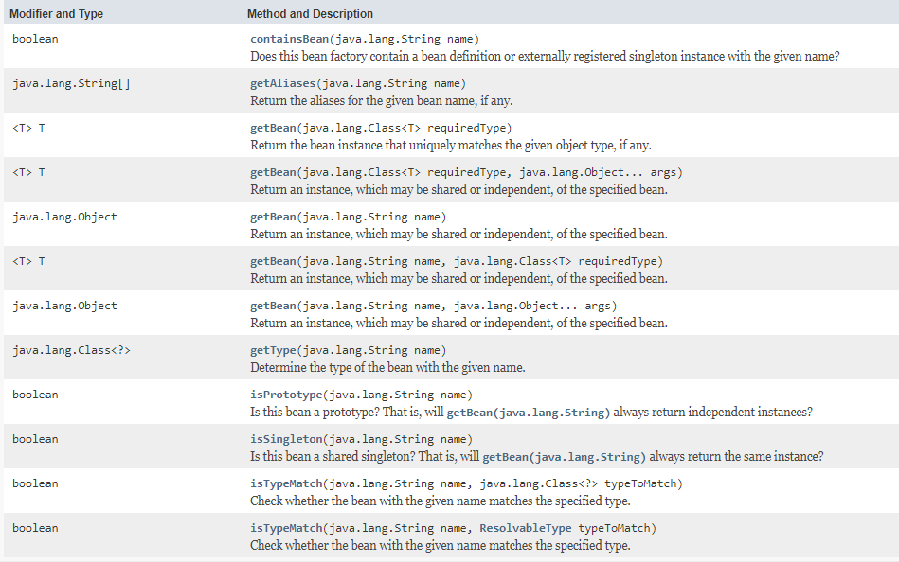
BeanFactory Interface methods

Slide 3
BeanFactory Interface methods
https://docs.spring.io/spring-framework/docs/current/javadoc-api/index.html?org/springframework/beans/factory/BeanFactory.html

